Slide 1
Case Study: Analyzing Churn Rate
NAME: Zeeshan Bhutto
Tool: Power BI
Objective:
1) Analyze the churn rate and identify key factors contributing to churn.
2)Provide actionable insights to reduce churn.
Problem Statement: Explain the issue of customer churn and why the company must address it.

Slide 2
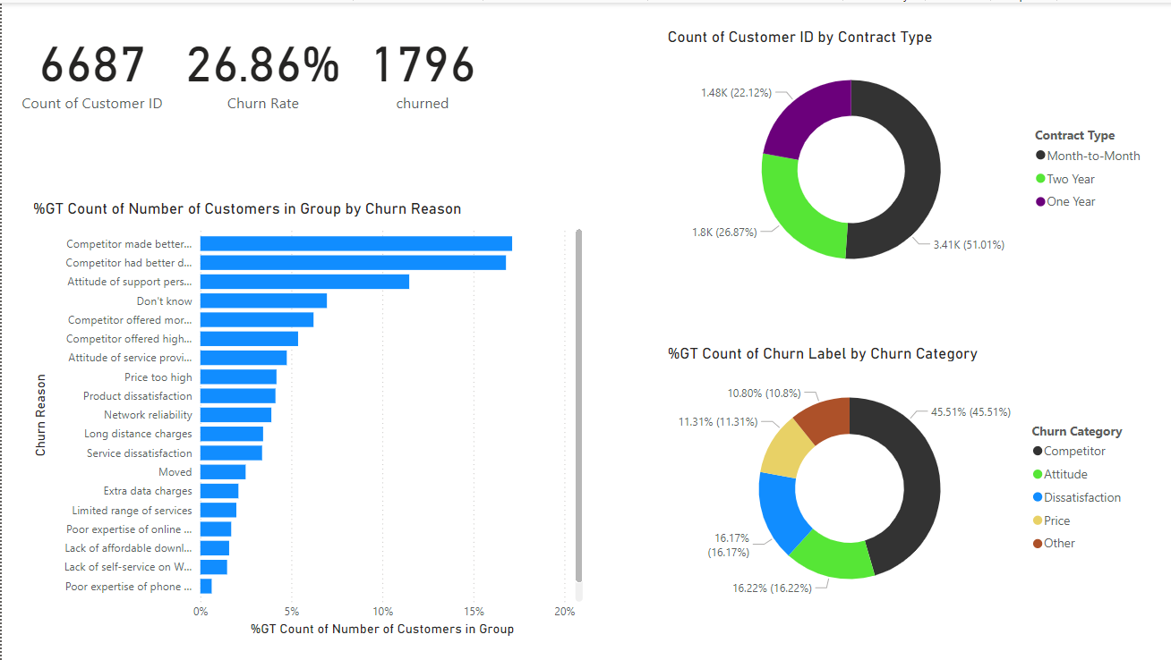
OVERVIEW

Slide 3
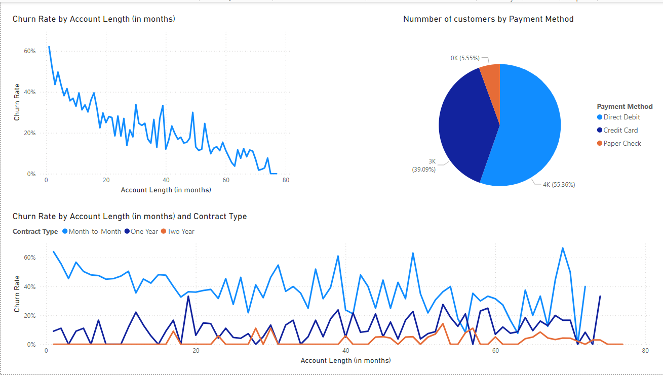
Contract-Type

Slide 4
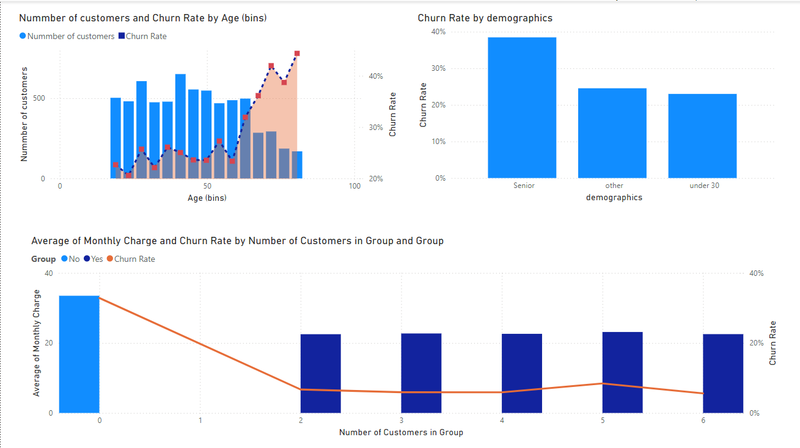

Slide 5
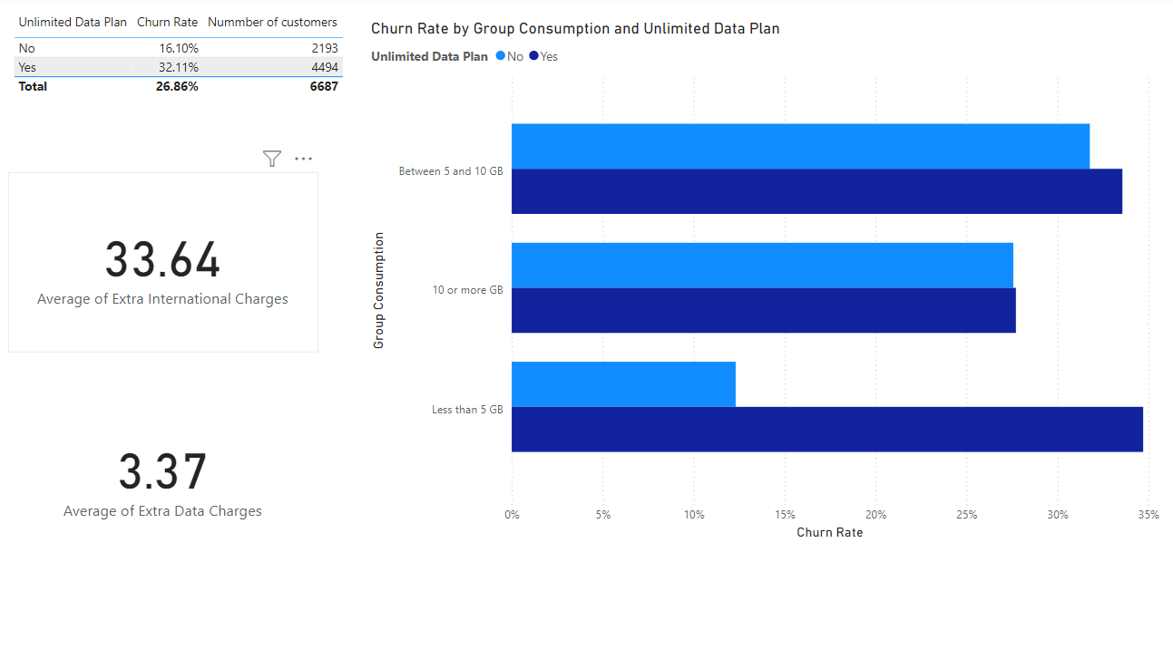

Slide 6
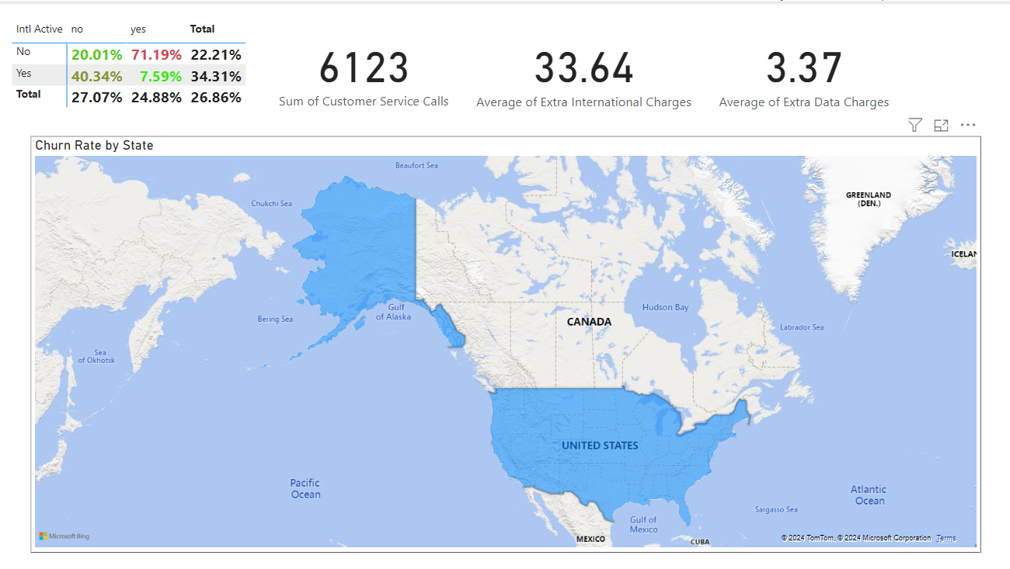

Slide 7
month-to-month customer churn rate is higher compared to the annual churn rate, Develop a structured plan to engage new customers during their first 90 days.
Gather feedback from your churned customers to understand what specific facilities or services they found more appealing than competitors.
Customers using less than 5 GB of data are churning more as compared to users.

